Slide 1

Introduction to Data Science FINAL PROJECT - CODON USAGE

Slide 2
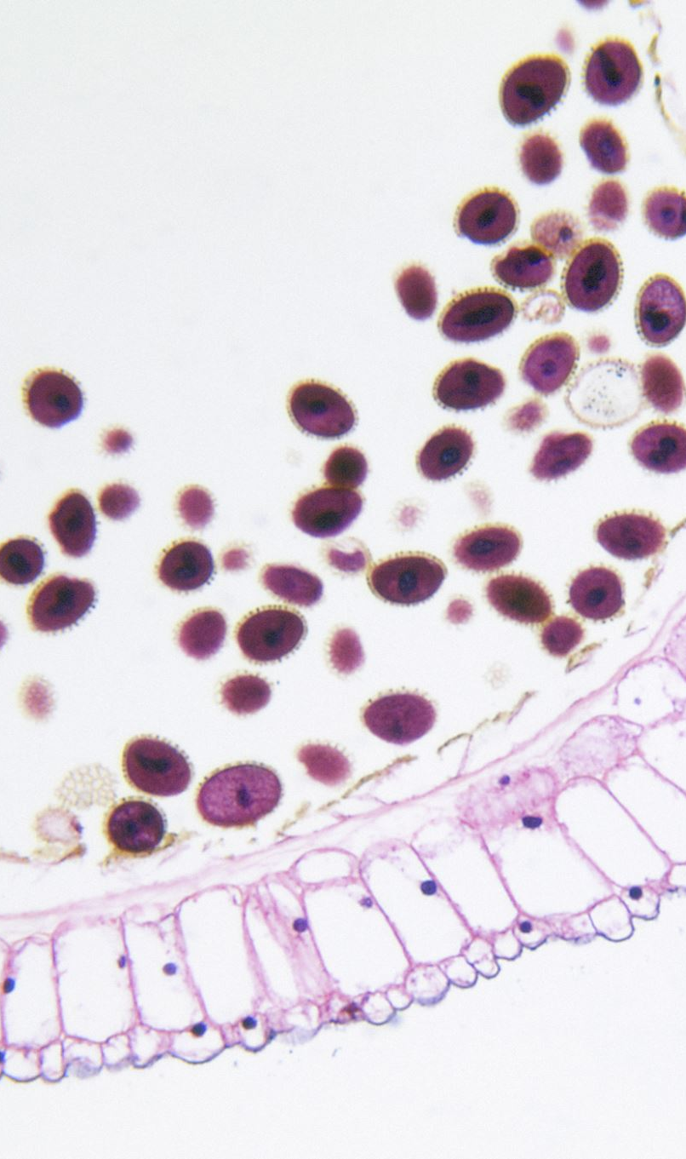
Introduction
The project involves analyzing DNA codon usage frequencies of a large sample of diverse biological organisms from different taxa.
The dataset contains multivariate features related to kingdom, DNA type, species ID, codon frequencies, and species names.
Kingdom: Represents different taxa such as archaea, bacteria, plasmids, plants, invertebrates, vertebrates, mammals, rodents, primates, and viruses.

Slide 3

Problem Overview
The aim is to analyze the DNA codon usage frequencies to understand patterns and relationships among different biological organisms from diverse taxa.
This analysis will involve classification and clustering tasks to identify distinct groups based on genomic composition and codon usage.
Business Constraints:
No low latency required
Interpretability is required
Probability score of organisms belonging to a particular class is required.

Slide 4
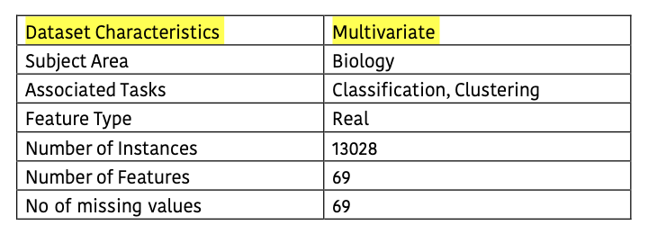
Dataset overview
The Codon Usage dataset contains 13,028 entries detailing codon frequency across organisms, with features like species identifiers, codon counts, DNA types, and biological classifications, supporting genetic analysis and comparisons.

Slide 5
Classes In Dataset
DNAtype: Denotes genomic composition with integer values representing various genomic types.
SpeciesID: Unique identifier for each species entry.
Ncodons: Sum of codon numbers in an entry, representing the total codon count.
SpeciesName: Descriptive label of species names. 6-69: Codon frequencies for nucleotide bases recorded as floating-point numbers.

Slide 6
Methodology (Part-A)
Data Collection: Gather the dataset containing DNA codon usage frequencies of diverse biological organisms.
Data Preprocessing: Handle missing values, normalize codon frequencies, and encode categorical features like kingdom and DNA type.
Feature Selection: Identify relevant features for classification and clustering tasks, focusing on genotype, behavior, and treatment.
Model Selection: Choose suitable machine learning algorithms – Ours is classification problem, so we have chosen Multiclass Logistic regression and KNN.

Slide 7
Methodology (Part-B)
Model Training: Train the selected models on the dataset, splitting it into training and testing sets.
Model Evaluation: Evaluate model performance using metrics like accuracy, precision, recall, and F1 score to assess classification and clustering results.
Feature Importance Analysis: Determine key proteins or codons that play a significant role in discriminating between different classes of biological organisms.
Results Interpretation: Interpret findings to understand the biological significance of identified patterns and relationships among diverse organisms.

Slide 8

Data preprocessing
The preprocessing of the Codon Usage dataset involved multiple steps to ensure data quality and readiness for analysis. The data was first imported using pandas, with its structure, column types, and initial statistics thoroughly explored. Non-numeric columns, such as Kingdom, were converted to numeric codes for computational purposes. Outliers were identified and removed using the IQR method, reducing the dataset from 13,028 rows to 3,744 rows while retaining essential information. The dataset was checked for missing and duplicate values, with no issues detected. Additional descriptive features, such as Kingdom_Names and DNAtype_Names, were added for better interpretability. The cleaned dataset was validated to ensure all columns contained numeric values and irrelevant rows were removed. Finally, the refined data was exported to .npz and .csv formats for further analysis and modeling.

Slide 9

Exploratory data analysis
Exploratory Data Analysis (EDA) is crucial for the Codon Usage dataset to ensure meaningful insights. It helps understand the dataset’s structure, including variables representing codon frequencies, and clarifies relationships between features. EDA identifies data quality issues such as missing or inconsistent values, outliers, and redundant features, which are common in biological data. Analyzing statistical distributions and correlations reveals patterns or anomalies, aiding in hypothesis generation and feature selection. Visualizations provide deeper insights into codon usage trends and biological relevance. Overall, EDA ensures the data is clean, comprehensible, and ready for modeling or further analysis in a structured and informed manner.

Slide 10
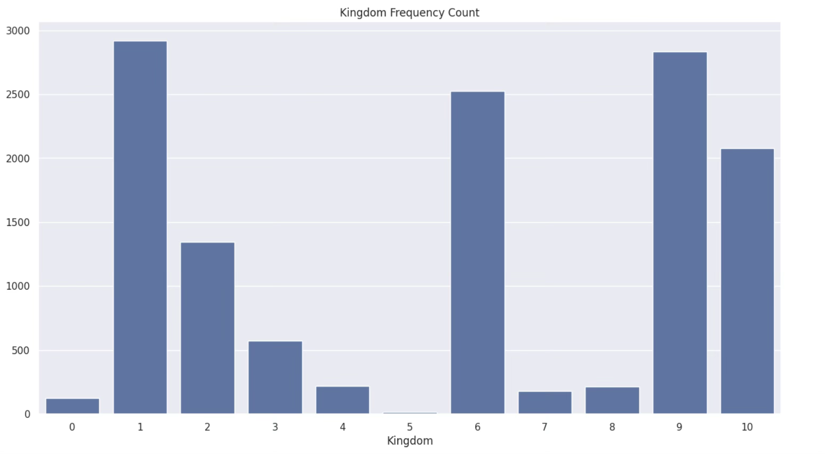
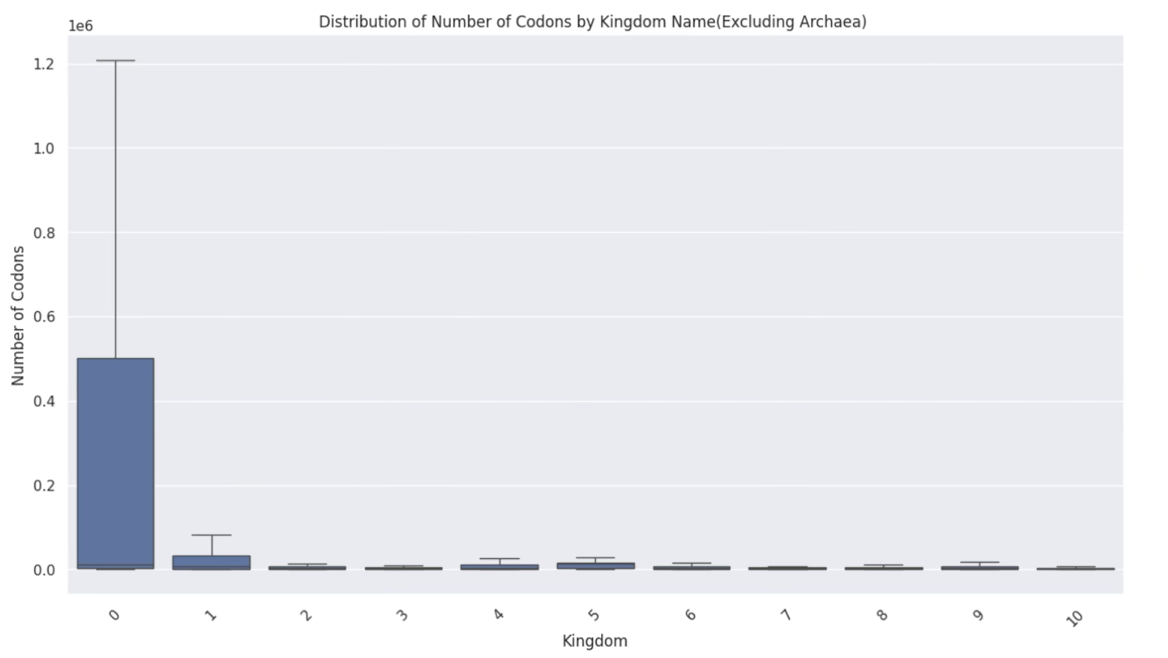
Exploratory Data Analysis
0: archaea
1: bacteria
2: bacteriophage
3: plasmid
4: plant
5: invertebrate
Fig:1 – Kingdom frequency Count
6: vertebrate
7: mammal
8: rodent
9: primate
10: virus
Fig:2 – Distribution of codons by Kingdom name

Slide 11

Exploratory data analysis
The bar chart shows uneven frequency distribution across kingdoms. Kingdoms bacteria, vertebrate, primate, and virus dominate with the highest counts, while archaea, plant, mammal, and rodent are underrepresented. Kingdoms bacteriophage and plasmid have moderate frequencies. This suggests potential biological diversity differences or sampling biases in the dataset.
The box plot shows codon counts by kingdom, with Kingdom archaea having significantly higher variability and maximum counts (>1 million) compared to others. Remaining kingdoms exhibit narrow distributions with lower codon counts. Kingdom archaea likely represents organisms with larger, diverse genomes, while others have smaller, less variable genomic structures.

Slide 12
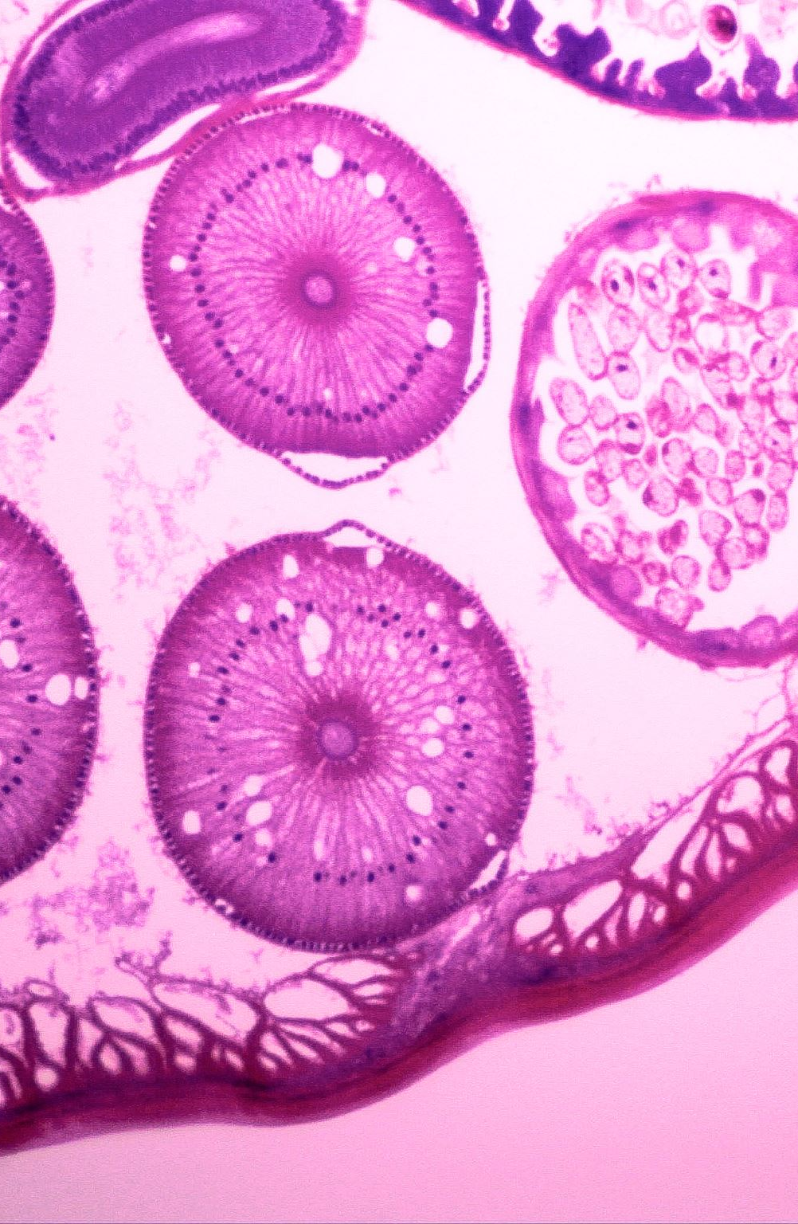
Deliverables
It was found that codon usage bias level can be useful for the prediction of the DNA type and Kingdom of the organisms.
These may be used in the cases of DNA obtained in the form of fossils (as we are not sure about the organism).
Feature engineering plays an important role, and it may have a huge impact in boosting model performance. The key to feature engineering is to have consultants with domain experts.

Slide 13
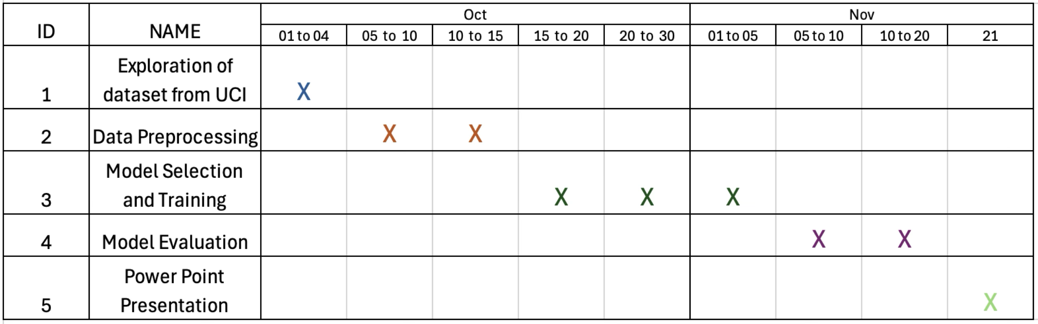
Progress Gantt chart
Fig:3 – Progress Gantt chart

Slide 14
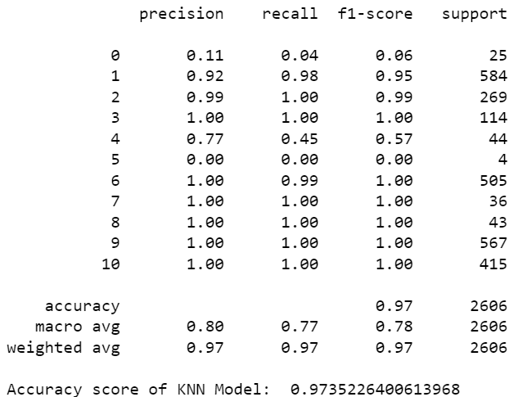
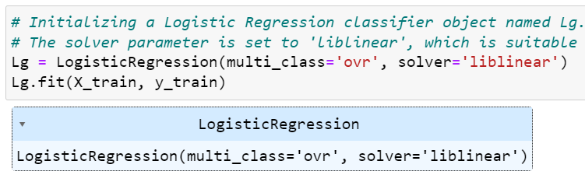
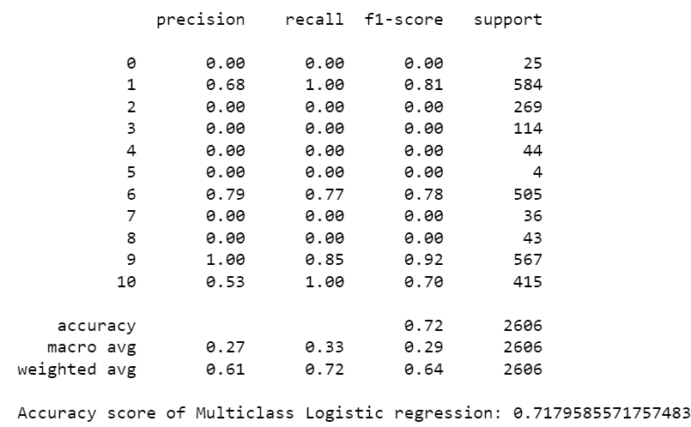
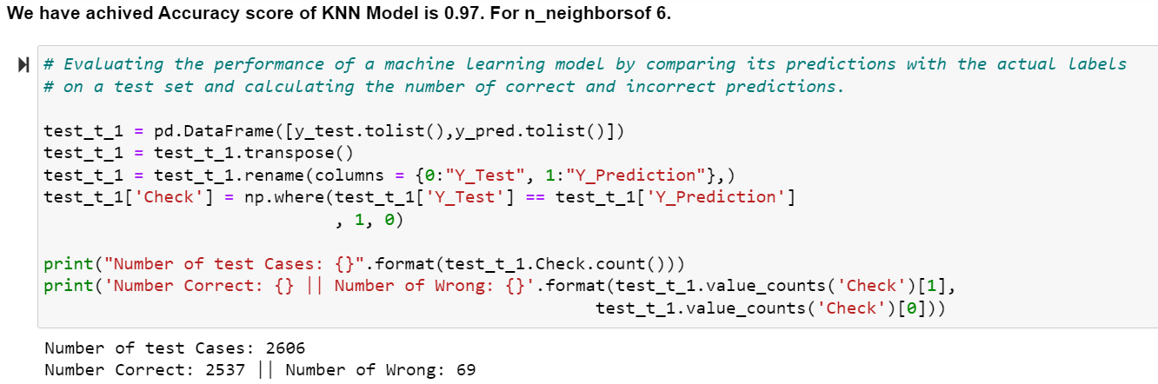
Results
KNeighborsClassifier
Multiclass Logistic Regression
Fig:6 – Applying Multiclass Logistic Regression
Fig:4 - Classification_report of KNN
Fig:5 – Evaluation of KNN Model performance
Fig:7 – Classification_report of Multiclass Logistic Regression

Slide 15
Future Work
Deep learning models can also be tried for prediction.
Custom models can be improved further to increase predictions.
Some new features can be engineered.
Instead of two different models for each task, we may also use a single model for the prediction of both DNA type and Kingdom.

Slide 16

Thank You

